Slide 1
Restaurant Order Data Analysis Using SQL

Slide 2
OBJECTIVE
Explore the menu_items table to get an idea of what’s on the menu
Explore the order_details table to get an idea of what’s on the data that’s been collected
Use both table to understand how customers are reacting to the menu

Slide 3
ER- DAIGRAM :
iteam_id category order_details_id order_id order_date
Menu_item_id
price order_time item_ id
Menu_items order_details

Slide 4
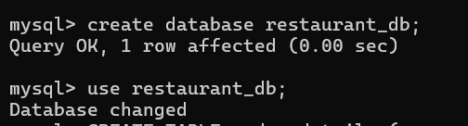
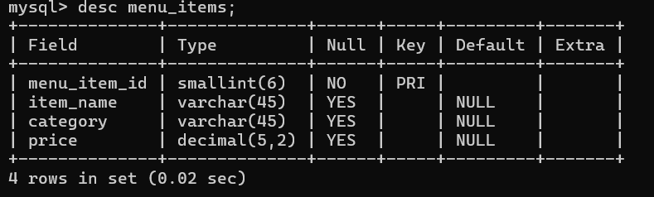
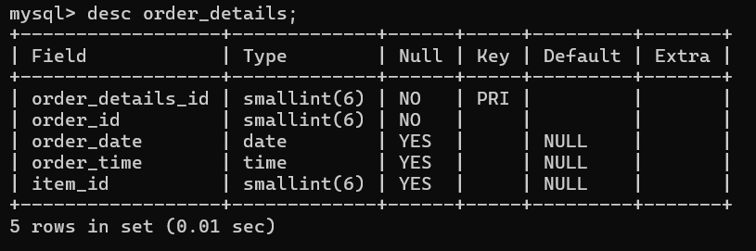
Structure Of Table

Slide 5
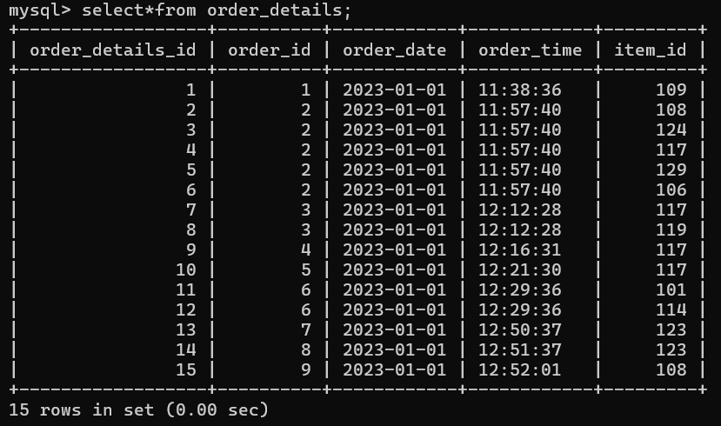
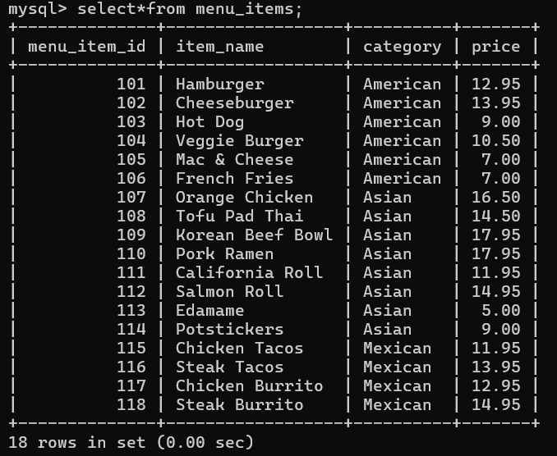
CONTENTS OF TABLES

Slide 6
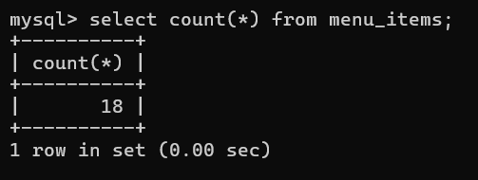
EXPLORE THE ITEMS TABLE
Find the number of items on the menu

Slide 7
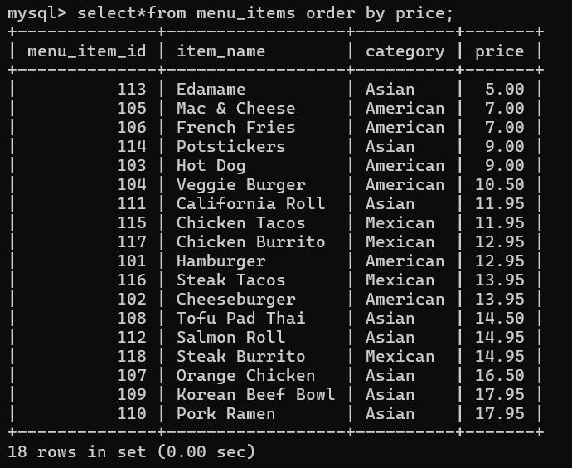
What are the least and most expensive items on the menu

Slide 8
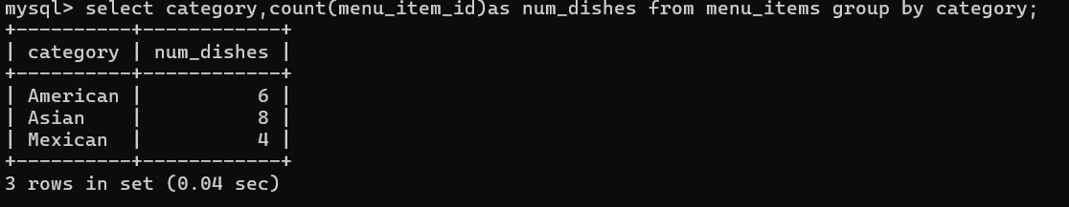
How many dishes are in category

Slide 9
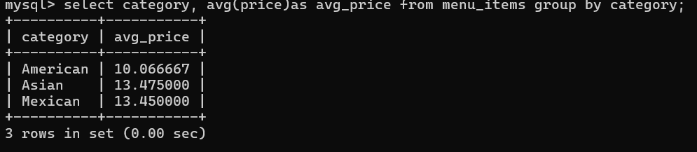
Avg dish price within each category

Slide 10
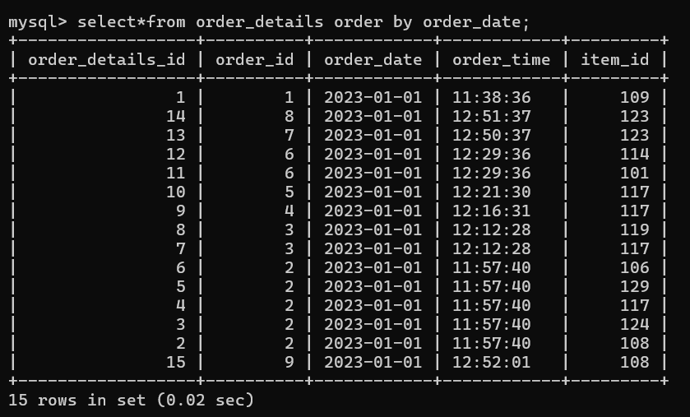
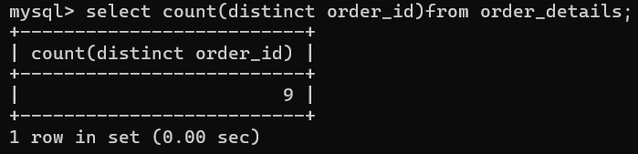
EXPLORE THE ORDERS TABLE
How many orders were made within this date range

Slide 11
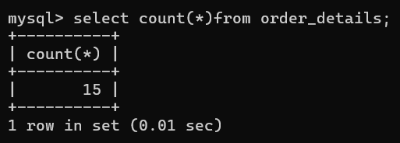
How many items were ordered within date range

Slide 12
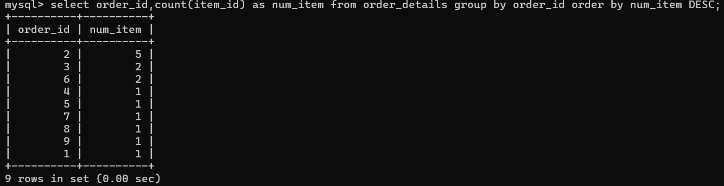
Which order had the most number of item

Slide 13
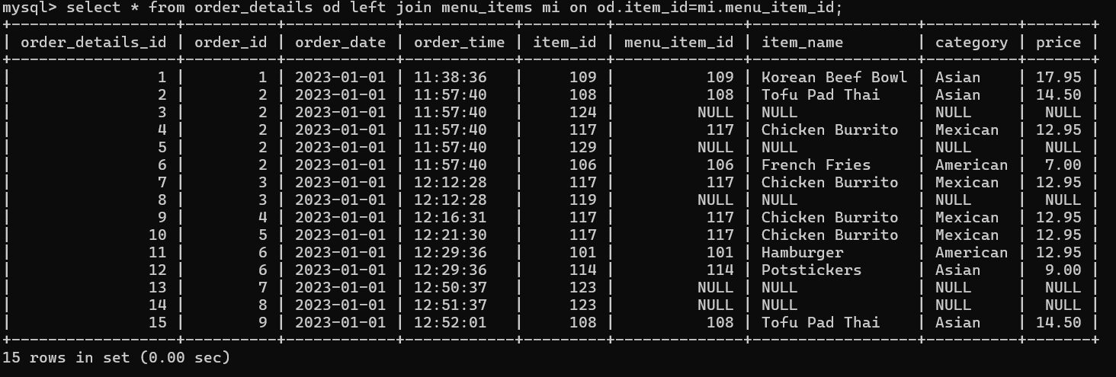
ANALYZE CUSTOMER BEHAVIOR
combine the menu_items and order_datails tables into a single table

Slide 14
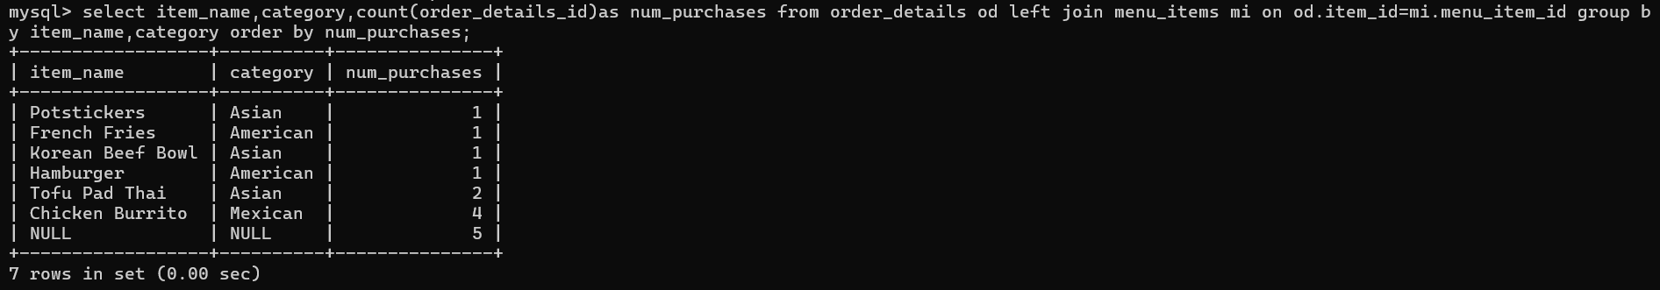
What were the least and most order items and what categories were they in

Slide 15
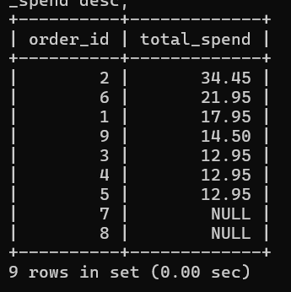
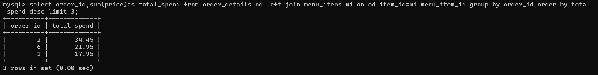
What were the top 3 orders that spent the most money

Slide 16
Thank You

